Slide 1

Intro to Python Data Analytics
Notes:
Use presenter view
Full screen
Run with Alt + F5 – then can share the full screen window to people

Slide 2

Agenda
Welcome
About myself
What do I hope you learn
What is Data Analytics
Why do it & how to make money?
Python as a tool
Data sourcing – CSV, SQL, API
Building a system
Scheduling
Tracking results
Inspiration
Chat GPT
Q&A

Slide 3
Welcome
The 3rd event / meeting from the London Python Meetup Group.
Lets see how this goes! Feedback appreciated.
Next events: AI? Art/Generative? Data Engineering?
More planned in 2023 – if you would like to speak or share something, please let me know!
Hope to do some in person events/meetups later in the year. Probably something informal.
Notes:
Thanks for coming along.

Slide 4

About me
MSc Computer Science, BA History
Worked in energy, commodities, trading
Built a lot of stuff, worn a lot of hats
Done 3rd Line out of hours support
Currently contracting with my own company
Read a lot of code for fun!
Full stack profile
Interested in helping people learn – pay it forward
AI, Recruitment, Startup Ideas
https://www.linkedin.com/in/alex-mcivor-26032287/

Slide 5
What do I hope you learn
This is an ‘Intro’ session
Cover the main concepts
Some practical lessons and tips – based on my own experience
Not focused on syntax and apis
Take a look at some code
System design – at a smaller practical scale
You probably aren’t Google
Some inspiration
Notes:
Just an introduction session, not super advanced. Cover quite a wide range
The main concepts that you need to get started with
My own experience, I hope it is some use/value. Not something you can read so much online
Not going to focus on indepth examination of how to sum a dataframe or make a pivot tables. The official docs are generally very good, and at least for myself I find it goes in one ear and out the other.
Will have a look at some code, pay more attention to the general idea of what it is trying to do – I will put that onto github.
Not perfect and can of course be improved

Slide 6
What is Data Analytics
Building the systems you need to extract value from data.
Answering some kind of question
Examples:
Looking at historical trends
Making a real-time prediction
Monitoring and detecting anomalies
Notes:
This is my definition of it, and what has helped me.
The first point is a key one – data analytics means different things to different people. Can get too wrapped up in the differences between data analyst, data science, data engineering
A very simple definition I have here – don’t worry too much about it all.

Slide 7
What is Data Analytics
1) Specify the question do you want to answer? The requirements
2) What data do you have?
3) Prepare or collect the data
4) Clean, process and store the data
5) Analyse the data / build your model
6) Deploy your model and system
7) Take action based on the result
Iterative development followed by robust operation
Notes:
These are all very important.

Slide 8
Why do it & how to make money?
Your model vs other models vs reality.
What & when is your ‘price out’? How does it work?
Can you just buy something?
Can you improve on something?
Get down into the detail & know everything, all the quirks.
Automation and efficiency

Slide 9

Why use Python?
It’s free!
Easy to get started with good tooling
In demand and popular – good for your c.v
Cross platform
The open source ecosystem is massive
Jupyter Notebooks, NumPy, SciPy, Pandas, Matplotlib
Notes:
Ask why is anyone else using Python?
Tools
Jupyter Notebook is a web-based IDE for experimenting with code and displaying the results. It is fairly popular among data scientists and machine learning practitioners.

Slide 10
Why not to use Python/alternatives?
It is slow vs compiled languages. But improving.
Dynamic Typing both pros & cons
Package & dependency management
Alternatives
MATLAB - https://www.mathworks.com/
Julia - https://julialang.org/
SQL ???
Notes:
Matlab – the IDE is fantastic, in a lot of ways inspired a lot of the current Python ecosystem for data analysis/science. But it is not free though. You get what you pay for!
Julia is designed from the ground up to be very good at numerical and scientific computing. This can be seen in the abundance of scientific tooling written in it.
It is fast, dynamically typed, open source and free.
SQL – often overlooked? Efficient to keep your data and analysis in once place. With more modern tooling it is possible to have a good test driven / devops approach. Both in terms of ddl migrations and local databases. Sometimes even just basic aggregation can be very helpful. Don’t always have to be so worried about scale. A big database server can get you a long way!
Transactions and the guarantees you get are very nice to have.
But if you are going to use it, don’t be afraid but do try to understand some of the setup a bit.

Slide 11
Data Sourcing – how are we going to get data
Files – CSV, JSON, XML, HDF5, Custom
APIs – REST, GraphQL, RPC
Databases – SQL, NoSQL, Datalakes (Databricks)
Internal or External to your organisation
Raw data vs result of other processes
Notes:
There are a range of different file formats
CSV & JSON some of the most common.
XML very powerful for schema validation properties – but often more complex to create. WCF services / web Microsoft tech that lost out to JSON HDF5 – designed for hierarchical & structured data storage and really big files. Common more in an academic setting often. More complex to use than CSV, but has good libraries
APIS – Rest or GraphQL. Rest probably the most common. Nice that you can easily have a look in your browser
Rest generally means JSON as far as the modern stack is concerned.
RPC – bit less common for data providers, more of an operational type of thing.
Databases -

Slide 12
How much data do you have?
My data is < 1GB – too much for excel.
My data is < 10GB – pandas + SSD + more ram + Dask. HDF5, Parquet
My data is 100GB + -> more thought required.
My data is < 1TB – 10TB (ish) – HDs, Mysql/Postgres/Views/Indexes. Single DB server possible
My data is < 10TB+ - More specialised tools. (Outside our scope here)
Notes:
https://www.chrisstucchio.com/blog/2013/hadoop_hatred.html – tongue in cheek, but makes a point
Exabyte = 1,000 Petabytes or 1 billion Gigabytes
https://www.projectpro.io/article/how-jpmorgan-uses-hadoop-to-leverage-big-data-analytics/142#:~:text=With%20more%20than%20150%20petabytes,with%20in%20the%20financial%20sector.

Slide 13
Cheat Sheets
Pandas, Numpy, Matplotlib, SciPy
Pretty much all large packages
Large APIs with dense documentation
Not good for the ‘happy path’.
Print them out!
Great for interview prep
Notes:
Pretty much every major package / library of note will have cheat sheets available
They generally have good docs, but often go into a lot of depth about every single possible way to use a piece of functionality. You are often just after the basic case. E.g. I just want to add up a dataframe and show a bar graph.
Useful for all experience levels – created with different ability/knowledge levels in mind.
Some can be on more niche areas of functionality.
Great use for a second screen or tablet.
Could compile your own page/documentation/index with them if you want
https://pandas.pydata.org/Pandas_Cheat_Sheet.pdf
https://matplotlib.org/cheatsheets/_images/handout-beginner.png
https://res.cloudinary.com/dyd911kmh/image/upload/v1676302459/Marketing/Blog/Numpy_Cheat_Sheet.pdf
A whole selection of sheets are available here:
https://ugoproto.github.io/ugo_py_doc/scipy_cs/

Slide 14
Foundations
Very important but it doesn’t differentiate you much
Boilerplate code is ☹
Standardised framework for yourself, team, company
Pick something and go with it
Accept limitations of your solution
https://github.com/drivendata/cookiecutter-data-science/
Notes:
It is important to get this right. Getting it wrong will hamper your project, but getting it right won’t ensure you succeed. It is not the ‘secret sauce’.
Like a real building, match your foundations to your size of project? Are you building a garden shed or a skyscraper? (Sheds often have a habit of turning into a 5 bedroom family home by the time you are done…)
Boilerplate code – it is boring to write, easy to get wrong, time consuming and doesn’t add much value. Accept there is someone better than you that has spent time making something.
Just choose – analysis paralysis can kill your project, don’t let perfection get in the way of getting something done.
Limitations – If you buy a car, do you immediately start modifying it? Can the business live with it. There are easy changes that can be made to packages/software and then there are hard changes. It isn’t always immediately obvious what is or isn’t difficult. Less technical people often don’t understand intuitively why it might be hard to ‘just move this graph to the left’, add an extra element or make one of the graphs use red bold font for the title. Get people to accept the scope of what you have done. Otherwise you can be doing a lot of work, for not much value.
Cookie Cutter data science – takes care of a lot for you, folder structure wise. So it is a good place to start. Widely recognised, will probably encounter it in other organisations you visit.

Slide 15
Gotchas and real world lessons
Use and understand virtual environments
Make sure it is repeatable easily
What about duplicates/corruption
We got the data, but it is bad
Show nothing at all
Performance & speed matters. Sort of…
Access and logging
Data format changes and flexibility
I want to go on holiday
Less data can be better
Build your toolbelt

Slide 16
Choose your level
Match the complexity and flexibility of your system to your organisation.
No points for not finishing – something is better than nothing.
Logging
Repeatability
Data versioning - very important consideration
Soft deletes
Console access
How much data do you have?
Batch, real-time or both?

Slide 17
Data Tiers
Bronze Tier – raw input data
Silver Tier – validated and cleaned data fit to your internal world
Gold Tier – aggregated & signed off set of data for use in models & reports
Platinum Tier* – fully mapped, up to date data owners & published schemas
Notes:
s

Slide 18
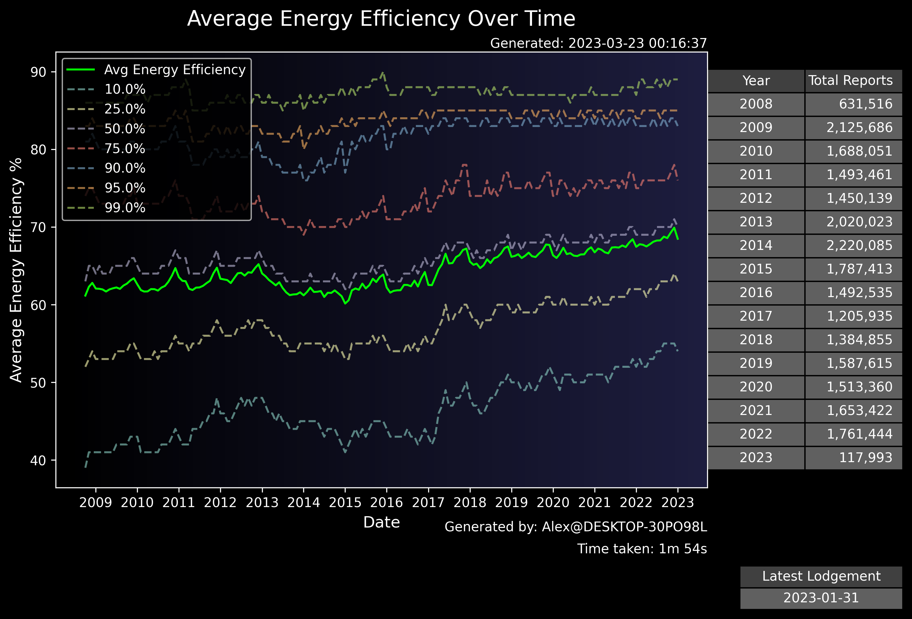
UK Housing Energy Efficiency Notebook
https://epc.opendatacommunities.org/
24,133,533 Records
5GB ZIP file
Updated monthly
Example of open data
A basic approach
10 minutes once per month?
jupyter nbconvert epc_analysis.ipynb --to script

Slide 19
Stepping Up - What are we going to build
A pipeline showing all the core stages of turning data into a useful insight and allowing others to take advantage of it.
Show extracting and transforming data
Storing data in SQLite
Create a basic dashboard to show our results
Notes:
Key focus is on it being simple and repeatable

Slide 20
BFI - London Weekend Box Office Takings
Quite a real world example
Tricky data scrape
Problems with the file names
Messy .xls file not designed for automated data processing
Not very consistent

Slide 21
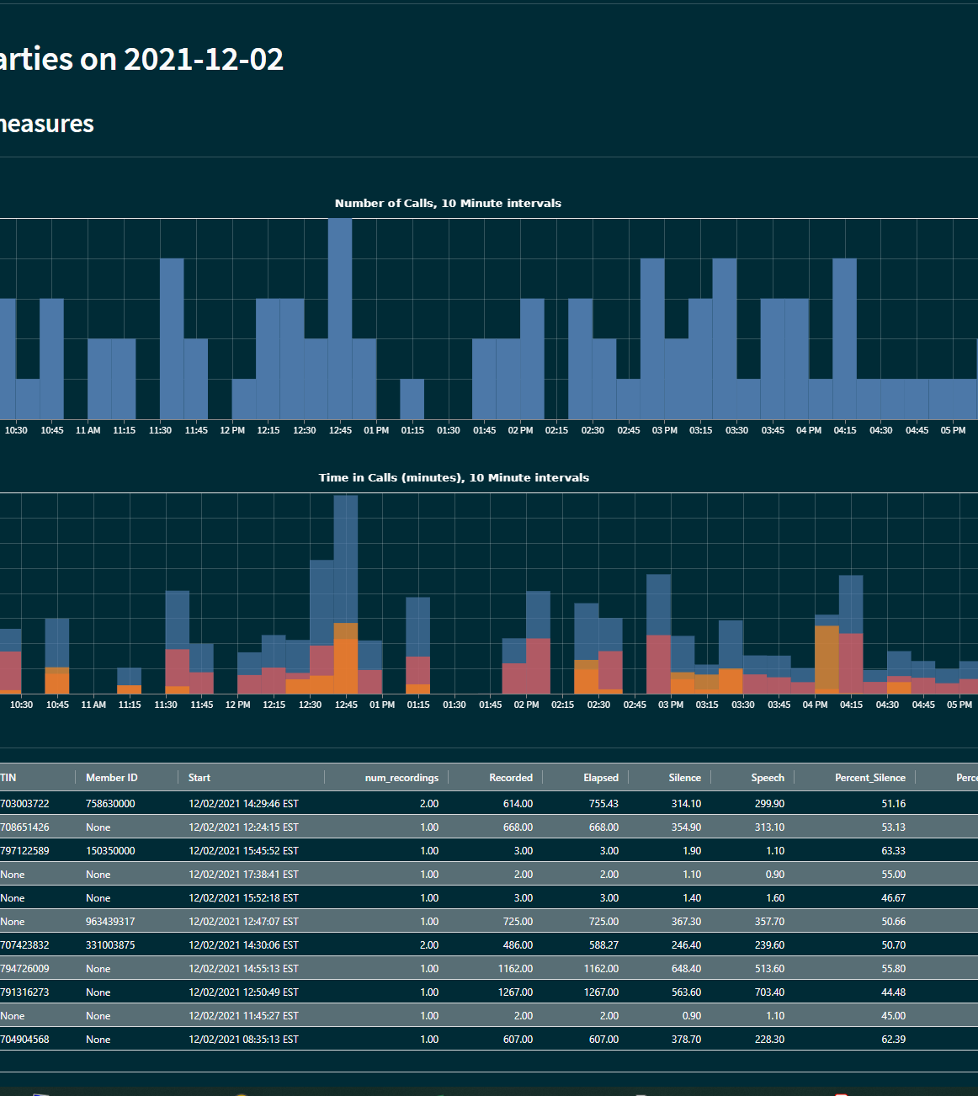
Streamlit - https://streamlit.io/
Moving on from Jupyter Notebooks
Productionising your work
How do you share your results?
https://streamlit.io/
Turn off usage stats

Slide 22
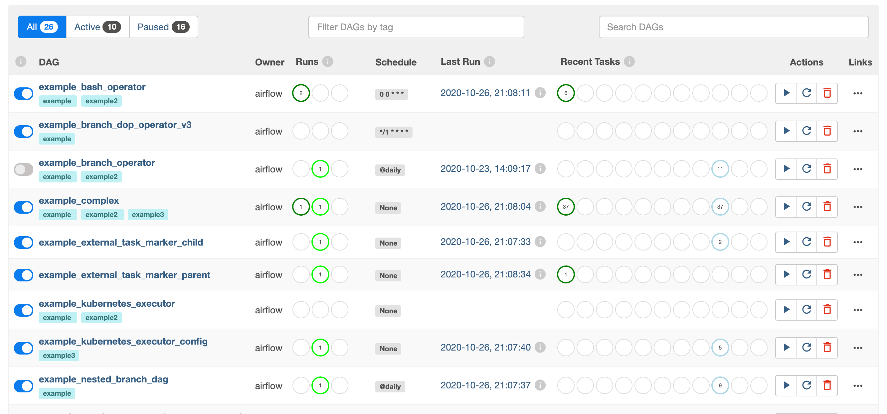
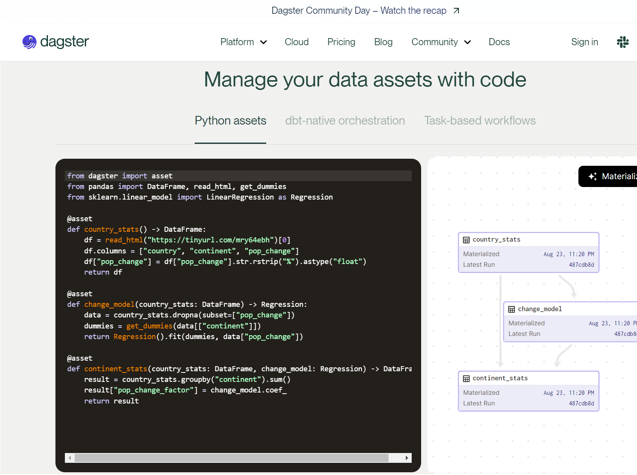
Scheduling
Bronze Tier – Windows Task Scheduler, Cron Jobs
Silver Tier – Airflow, Luigi, Commercial Automation
Gold Tier – Dagster (Just my opinion)
Notes:
Bronze Tier – Avoid these if you can, but enough to get you working. Cron probably better than Windows Task Scheduler. Problems of deployment, user accounts to run under, keeping track etc. Dependency management is difficult
Silver Tier – Moving onto much better tools, designer around DAGS – ie computational graphs Airflow + Luigi – both have nice Uis to help. Silver tier because setting up local environments can be hard. Luigi has been around a while Airflow. 28k stars Airflow vs 16k Used at Spotify Gold Tier – Dagster https://dagster.io/
A new piece of software / application. More of a code first attitude to data pipelines. Emphasis on being able to run things locally as a developer. Ie putting into code the environments themselves

Slide 23
MLFlow https://mlflow.org
MLflow is an open source platform to manage the ML lifecycle, including experimentation, reproducibility, deployment, and a central model registry.
Four key elements
Tracking – record experiments & config
Projects – packaging your code
Models – deploy models
Repository – store your models
Alternatives
Weights & Biases https://wandb.ai/site
Kedro https://demo.kedro.org
Notes:
Tracking - Record and query experiments: code, data, config, and results
Projects - Package data science code in a format to reproduce runs on any platform
Models - Deploy machine learning models in diverse serving environments
Registry - Store, annotate, discover, and manage models in a central repository
Alternatives: Weights & Biases – focused on deep learning and primarily cloud based. Can do local hosting for your personal projects
Kedro – Python framework for creating reproducible, maintainable and modular data science code. Originally created by employees at QuantumBlack – data science consultancy now part of McKinsey

Slide 24
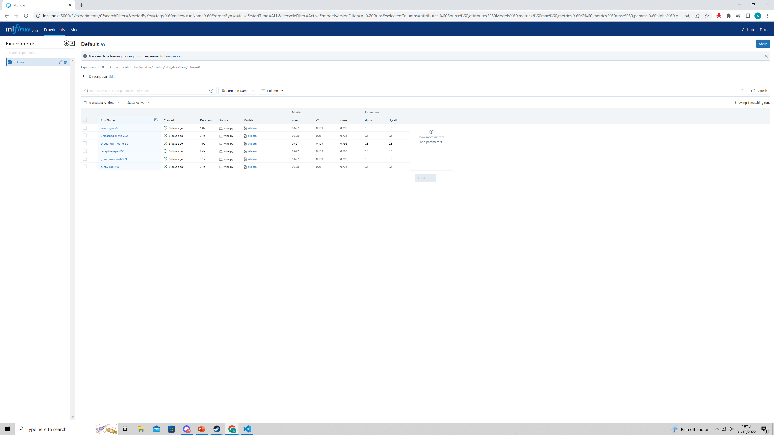
MLFlow Demo
https://mlflow.org/docs/latest/quickstart.html
Notes:
Cd redwine
mlflow ui
http://127.0.0.1:5000

Slide 25

Netflix
https://netflixtechblog.com/match-cutting-at-netflix-finding-cuts-with-smooth-visual-transitions-31c3fc14ae59
They have a lot of data
They have a lot of expertise
They have a lot of computing power
But! Can you take something away?
The approach and general ethos – solving a problem or real world output.
“At Netflix, we’ve been leveraging experimentation and the scientific method for decades”
Notes:
How Netflix created ‘match cuts’ – a specific type of film cut where both shots fit very well together.
Used to automate the process of finding these, as it helps create engaging trailers for people
In film, a match cut is a transition between two shots that uses similar visual framing, composition, or action to fluidly bring the viewer from one scene to the next.
It is a powerful visual storytelling tool used to create a connection between two scenes. Optical flow
Cosine similarity Not strictly data analysis – but not so complicated it is impossible to understand

Slide 26
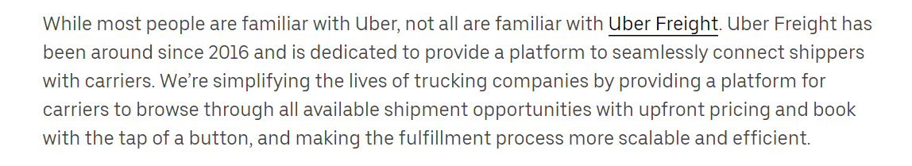
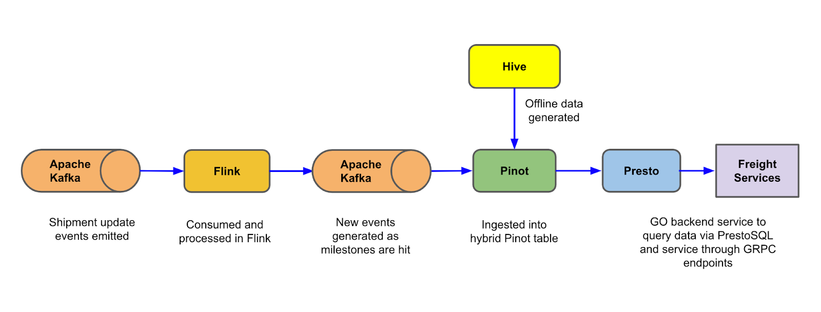
Uber
https://www.uber.com/en-GB/blog/uber-freight-carrier-metrics-with-near-real-time-analytics/
Notes:
How Uber used kafka to speed up their carrier metrics
To achieve this, Uber Freight developed the Carrier Scorecard to show the carriers several metrics,
Including engagement with the app, on-time pickup/delivery, tracking automation, and late cancellations. By showing this information in near real time on the Carrier App, we are able to provide feedback to carriers in real time and set ourselves apart from most of our competitors in the industry
Basically moving on from Mysql Real time freight processing data – how to handle this

Slide 27

Uber Takeaways
Scale is a good problem to have
Powerful tools are there if you need them
They are expensive – both cpu & people
Did they really need real time?
Lambda data architecture

Slide 28
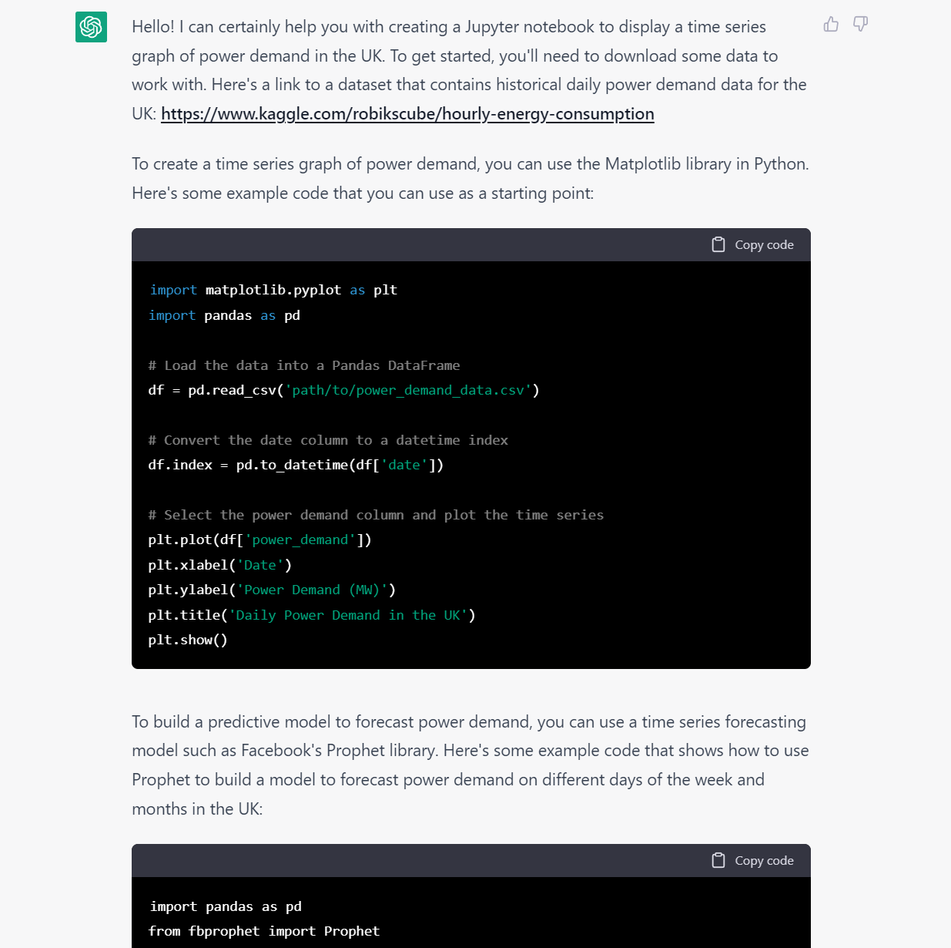
Chat GPT
https://chat.openai.com/chat
A must try if you haven’t yet!
Version 4 recently released.
$20/month for access
Currently helpful as an apprentice or source of inspiration
Warning – there are mistakes
Think Monkey’s Paw. Be specific.
5 years from now!?
Notes:
Hi ChatGPT, can you help me write some python code. I want to create a Jupyter notebook to display a time series graph of power demand in the UK. Can you include a link to some historical data you know about as well that I can download from the internet. Can you also include some Python code for how we can build a predictive model to forecast power demand on different days of the week and months in the UK?
Hello! I can certainly help you with creating a Jupyter notebook to display a time series graph of power demand in the UK. To get started, you'll need to download some data to work with. Here's a link to a dataset that contains historical daily power demand data for the UK: https://www.kaggle.com/robikscube/hourly-energy-consumption
To create a time series graph of power demand, you can use the Matplotlib library in Python. Here's some example code that you can use as a starting point:
import matplotlib.pyplot as plt import pandas as pd # Load the data into a Pandas DataFrame df = pd.read_csv('path/to/power_demand_data.csv') # Convert the date column to a datetime index df.index = pd.to_datetime(df['date']) # Select the power demand column and plot the time series plt.plot(df['power_demand']) plt.xlabel('Date') plt.ylabel('Power Demand (MW)') plt.title('Daily Power Demand in the UK') plt.show()
To build a predictive model to forecast power demand, you can use a time series forecasting model such as Facebook's Prophet library. Here's some example code that shows how to use Prophet to build a model to forecast power demand on different days of the week and months in the UK:
import pandas as pd from fbprophet import Prophet # Load the data into a Pandas DataFrame df = pd.read_csv('path/to/power_demand_data.csv') # Convert the date column to a datetime index and rename it to 'ds' df['ds'] = pd.to_datetime(df['date']) # Rename the power demand column to 'y' df['y'] = df['power_demand'] # Create a Prophet model model = Prophet() # Add weekly and monthly seasonality to the model model.add_seasonality(name='weekly', period=7, fourier_order=3) model.add_seasonality(name='monthly', period=30.5, fourier_order=3) # Fit the model to the data model.fit(df) # Create a dataframe to hold the forecast future = model.make_future_dataframe(periods=365) # Make the forecast forecast = model.predict(future) # Plot the forecast model.plot(forecast) plt.show()

Slide 29

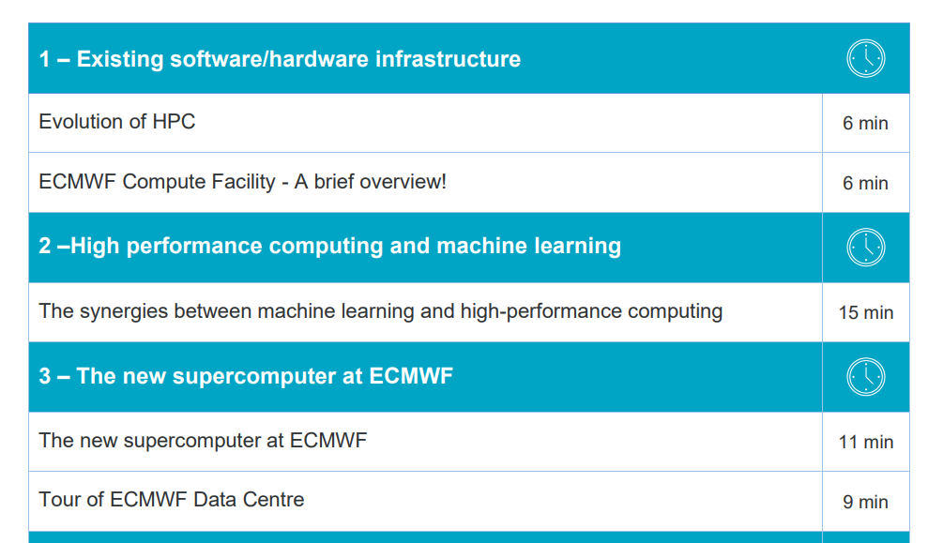
ECMWF MOOC
Started 9th Jan 2023
Free course – 3 tiers/tracks
Looks very high quality + qualified instructors
Machine Learning + Weather & Climate
Sign up: https://www.ecmwf.int/mlwc-mooc
Has a helpful forum/community

Slide 30
Questions & Thanks!
Any questions?
Slides + code will be posted on Github
Will send links for this
Feedback very much appreciated

